Slide 1

Harper Adams Python Enthusiasts Group HAP-E Group launch
HAP-E!
2021-07-09
Ed Harris

Slide 2
HAP-E Group
(What is it all about?)
Lunchtime tutorials
(email Ed if you would like to be added to the mailing list)
Skills, programming, algorithms, data science

Slide 3


Best at statistics | X
Best at artificial intelligence |  | X
Scientific computing | X | X
Needed for "data science" | X | X
Easy | X | X
Easy for non-programmers | X
Most popular for normal science | X
Most popular for comp science |  | X

Slide 4







Slide 5
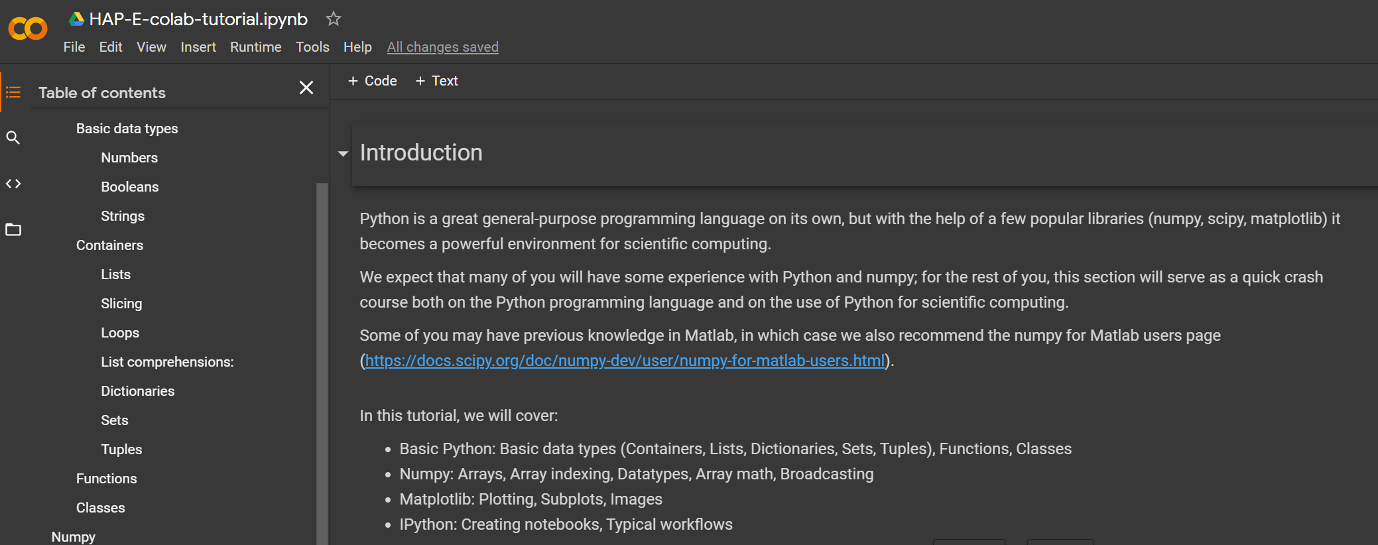
live Colab tutorial - set up and follow along

